Slide 1
Sass and CoffeeScript with Visual Studio
Topeka .Net User Group
October 2011

Slide 2

Who am I?
Brian Moon
Who do I work for: Adventure Tech
Twitter: @nairbnoom
GitHub: https://github.com/brianmoon/
Email: brian.moon@gmail.com
Developing for 15 years

Slide 3
What am I going to talk about?
Tools
CoffeeScript
Sass

Slide 4
Tools

Slide 5
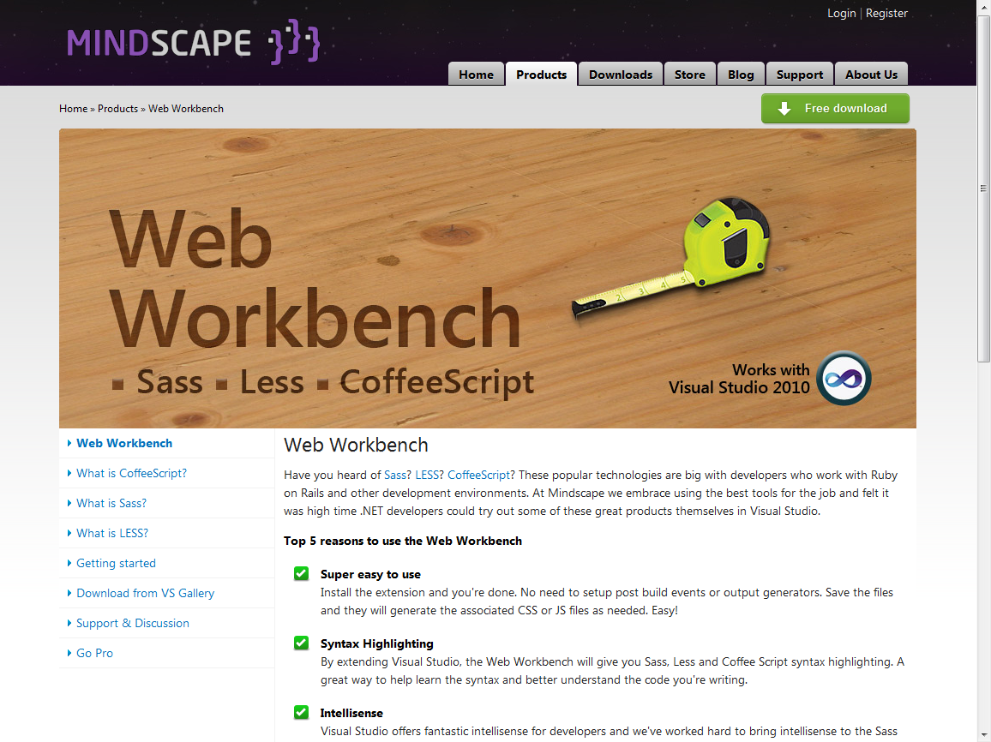
Mindscape Web Workbench

Slide 6
What does it do?
Allows you to use LESS, Sass, and CoffeeScript in Visual Studio
Provides
File Templates
Build Providers
Syntax Highlighting
Intellisense

Slide 7
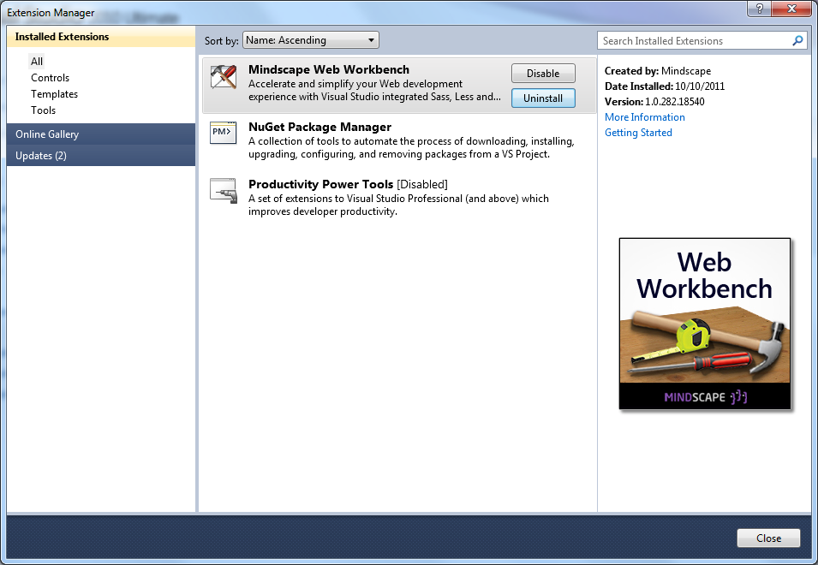
How do I install it?

Slide 8
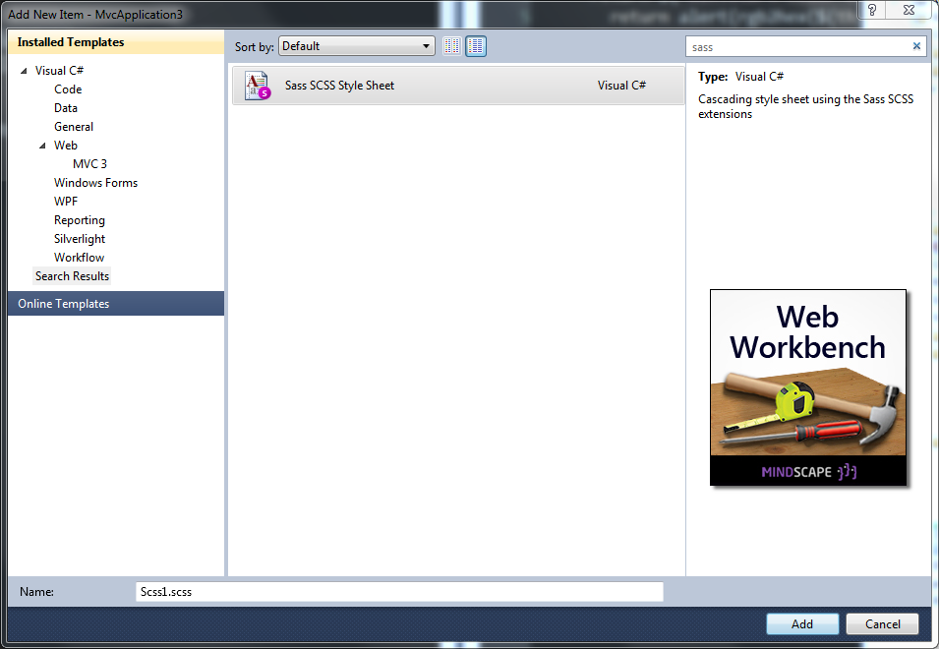
Adding a file

Slide 9
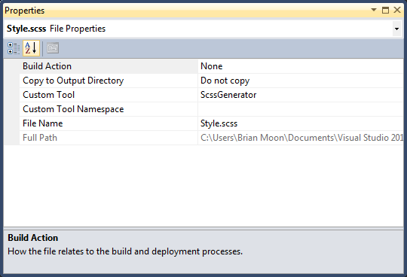
How does it work?

Slide 10

How do I use it in my project?
<link href="@Url.Content("~/Content/sass/style.css")" rel="stylesheet" type="text/css" />

Slide 11
coffeescript

Slide 12
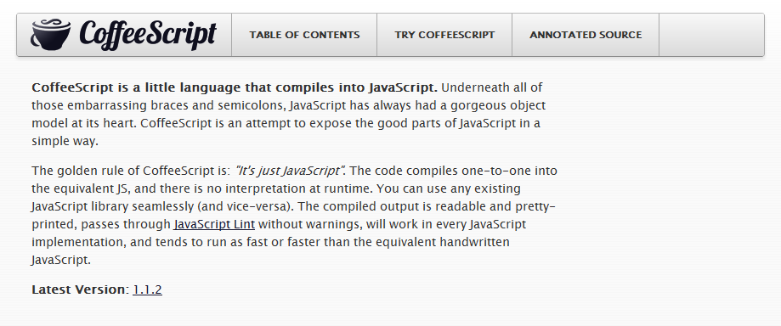
What is it?
http://jashkenas.github.com/coffee-script/

Slide 13
What does it do?
Makes writing “good” JavaScript easier
Helps avoid global namespace pollution
Easier to read code

Slide 14
Assignment
number = 42
opposite = true
(function() {
var number, opposite;
number = 42;
opposite = true;
}).call(this);

Slide 15
Conditions
opposite = false
number = -42 if opposite
(function() {
var number, opposite;
opposite = false;
if (opposite) {
number = -42;
}
}).call(this);

Slide 16
Conditions
if happy and knowsIt
clapsHands()
else
showIt()
(function() {
if (happy && knowsIt) {
clapsHands();
} else {
showIt();
}
}).call(this);

Slide 17
Conditions
whatToDo = if friday then goOut else stayHome
(function() {
var whatToDo;
whatToDo = friday ? goOut : stayHome;
}).call(this);

Slide 18
Functions
square = (x) -> x * x
(function() {
var square;
square = function(x) {
return x * x;
};
}).call(this);

Slide 19
Objects
square = (x) -> x * x
math =
root: Math.sqrt
square: square
cube: (x) -> x * square x
(function() {
var math, square;
square = function(x) {
return x * x;
};
math = {
root: Math.sqrt,
square: square,
cube: function(x) {
return x * square(x);
}
};
}).call(this);

Slide 20
Existence
alert "I knew it!" if elvis?
(function() {
if (typeof elvis !== "undefined" && elvis !== null) {
alert("I knew it!");
}
}).call(this);

Slide 21
Loops
yearsOld = rich: 10, tim: 9, rob: 7
ages = for child, age of yearsOld
"#{child} is #{age}"
(function() {
var age, ages, child, yearsOld;
yearsOld = {
rich: 10,
tim: 9,
rob: 7
};
ages = (function() {
var _results;
_results = [];
for (child in yearsOld) {
age = yearsOld[child];
_results.push("" + child + " is " + age);
}
return _results;
})();
}).call(this);

Slide 22
Array Comprehension
list = [1, 2, 3, 4, 5]
square = (x) -> x * x
math =
root: Math.sqrt
square: square
cube: (x) -> x * square x
cubes = (math.cube num for num in list)
(function() {
var cubes, list, math, num, square;
list = [1, 2, 3, 4, 5];
square = function(x) {
return x * x;
};
math = {
root: Math.sqrt,
square: square,
cube: function(x) {
return x * square(x);
}
};
cubes = (function() {
var _i, _len, _results;
_results = [];
for (_i = 0, _len = list.length; _i < _len; _i++) {
num = list[_i];
_results.push(math.cube(num));
}
return _results;
})();
}).call(this);

Slide 23
Array Slicing
numbers = [0, 1, 2, 3, 4, 5, 6, 7, 8, 9]
numbers[3..6] = [-3, -4, -5, -6]
(function() {
var numbers, _ref;
numbers = [0, 1, 2, 3, 4, 5, 6, 7, 8, 9];
[].splice.apply(numbers, [3, 4].concat(_ref = [-3, -4, -5, -6])), _ref;
}).call(this);

Slide 24
Embedding JavaScript
hi = `function() { return [document.title, "Hello JavaScript"].join(": "); }`
(function() {
var hi;
hi = function() {
return [document.title, "Hello JavaScript"].join(": ");
};
}).call(this);

Slide 25
Operators
is
isnt
not
and
or
true, yes, on
false, no, off
@, this
of
in
===
!==
!
&&
||
true
false
this
in
No equivalent

Slide 26
CoffeeScript Demo

Slide 27
Sass

Slide 28
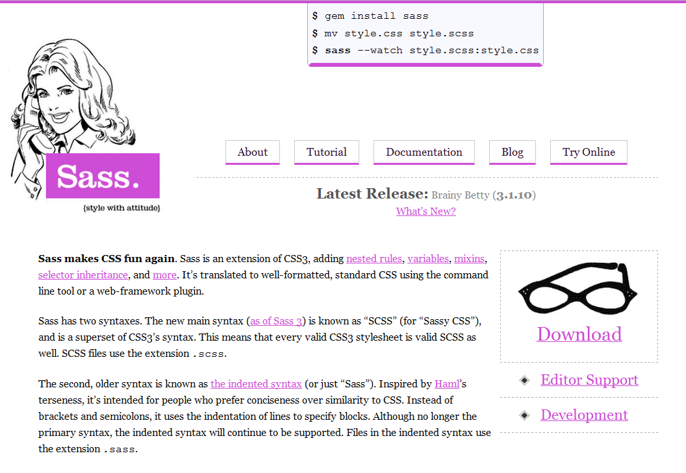
What is it?
http://sass-lang.com/

Slide 29
What does it do?
Makes CSS cleaner and easier to maintain
Easier to read code
Provides a better separation between style and content
Separate files without performance loss
Avoids repetition

Slide 30
Nesting
#navbar {
width: 80%;
height: 23px;
ul {
list-style-type: none;
li {
float: left;
a { font-weight: bold; }
}
}
}
#navbar {
width: 80%;
height: 23px;
}
#navbar ul {
list-style-type: none;
}
#navbar ul li {
float: left;
}
#navbar ul li a {
font-weight: bold;
}

Slide 31
Nesting
.fakeshadow {
border : {
style: solid;
left: {
width: 4px;
color: #888;
}
right: {
width: 2px;
color: #ccc;
}
}
}
.fakeshadow {
border-style: solid;
border-left-width: 4px;
border-left-color: #888;
border-right-width: 2px;
border-right-color: #ccc;
}

Slide 32
Parent References
a {
color: #ce4dd6;
&:hover { color: #ffb3ff; }
&:visited { color: #c458cb; }
}
a {
color: #ce4dd6;
}
a:hover {
color: #ffb3ff;
}
a:visited {
color: #c458cb;
}

Slide 33
Variables
$main-color: #ce4dd6;
$style: solid;
#navbar {
border-bottom: {
color: $main-color;
style: $style;
}
}
a {
color: $main-color;
&:hover { border-bottom: $style 1px; }
}
#navbar {
border-bottom-color: #ce4dd6;
border-bottom-style: solid;
}
a {
color: #ce4dd6;
}
a:hover {
border-bottom: solid 1px;
}

Slide 34
Operations and Functions
#navbar {
$navbar-width: 800px;
$items: 5;
$navbar-color: #ce4dd6;
width: $navbar-width;
border-bottom: 2px solid $navbar-color;
li {
float: left;
width: $navbar-width/$items - 10px;
background-color: lighten($navbar-color, 20%);
&:hover {
background-color: lighten($navbar-color, 10%);
}
}
}
#navbar {
width: 800px;
border-bottom: 2px solid #ce4dd6;
}
#navbar li {
float: left;
width: 150px;
background-color: #e5a0e9;
}
#navbar li:hover {
background-color: #d976e0;
}

Slide 35
Interpolation
$side: left;
$radius: 10px;
.rounded- {
border-top-#{$side}-radius: $radius;
-moz-border-radius-top#{$side}: $radius;
-webkit-border-top-#{$side}-radius: $radius;
}
.rounded- {
border-top-left-radius: 10px;
-moz-border-radius-topleft: 10px;
-webkit-border-top-left-radius: 10px;
}

Slide 36
Mixins
@mixin rounded {
$radius: 10px;
border-radius: $radius;
-moz-border-radius: $radius;
-webkit-border-radius: $radius;
}
#navbar li { @include rounded; }
#footer { @include rounded; }
#navbar li {
border-radius: 10px;
-moz-border-radius: 10px;
-webkit-border-radius: 10px;
}
#footer {
border-radius: 10px;
-moz-border-radius: 10px;
-webkit-border-radius: 10px;
}

Slide 37
Mixin Arguments
@mixin rounded($side, $radius: 10px) {
border-top-#{$side}-radius: $radius;
-moz-border-radius-top#{$side}: $radius;
-webkit-border-#{$side}-radius: $radius;
}
#navbar li { @include rounded(left); }
#footer { @include rounded(right, 5px); }
#sidebar { @include rounded(left, 8px); }
#navbar li {
border-top-left-radius: 10px;
-moz-border-radius-topleft: 10px;
-webkit-border-left-radius: 10px;
}
#footer {
border-top-right-radius: 5px;
-moz-border-radius-topright: 5px;
-webkit-border-right-radius: 5px;
}
#sidebar {
border-top-left-radius: 8px;
-moz-border-radius-topleft: 8px;
-webkit-border-left-radius: 8px;
}

Slide 38
Imports
/* _rounded.scss */
@mixin rounded($side, $radius: 10px) {
border-#{$side}-radius: $radius;
-moz-border-radius-#{$side}: $radius;
-webkit-border-#{$side}-radius: $radius;
}
#navbar li {
border-top-radius: 10px;
-moz-border-radius-top: 10px;
-webkit-border-top-radius: 10px;
}
#footer {
border-top-radius: 5px;
-moz-border-radius-top: 5px;
-webkit-border-top-radius: 5px;
}
#sidebar {
border-left-radius: 8px;
-moz-border-radius-left: 8px;
-webkit-border-left-radius: 8px;
}
/* style.scss */
@import "rounded";
#navbar li { @include rounded(top); }
#footer { @include rounded(top, 5px); }
#sidebar { @include rounded(left, 8px); }

Slide 39
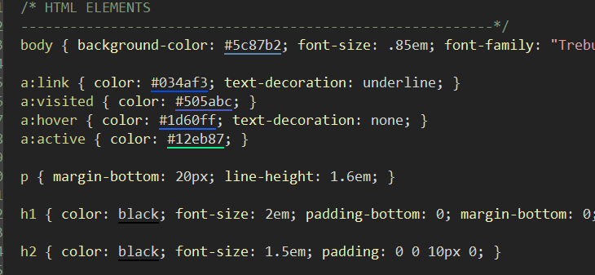
Output styles - Compact
//* scss-compile-options: :style => :compact

Slide 40
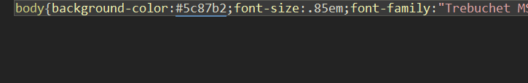
Output styles - Compressed
//* scss-compile-options: :style => :compressed

Slide 41
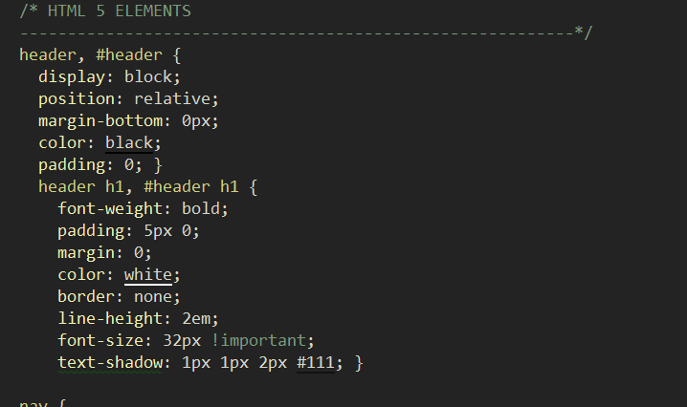
Output styles - Nested
//* scss-compile-options: :style => :nested

Slide 42
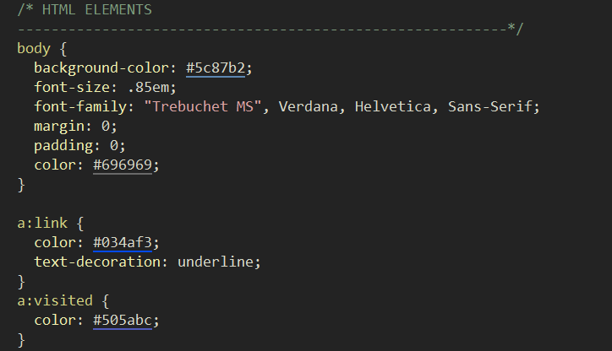
Output styles - Expanded
//* scss-compile-options: :style => :expanded

Slide 43
Sass Demo

